Slide 1
BEEKEEPING
Edgar Bowa
Ms.
Email:
Tel: +260 964834475
MSc. Sustainable Land and Environmental Management-UNZA

Slide 2
CONTENT
Definitions
Terminologies
Brief history of beekeeping in Zambia
Importance of beekeeping
Biology and Ecological

Slide 3
DEFINITION
Beekeeping is a branch of science which deals with sustainable caring and rearing of honey bee colonies in beehives for the economic benefits of man.
Academicians refer to this subject as apiculture because a beekeeper is always known as an Apiculturist.
A beehive is a name given to any container in which bees are managed by a beekeeper.

Slide 4
BRIEF HISTORY OF BEEKEEPING ZAMBIA
Beekeeping in Zambia was stimulated by the wax trade which was started by the Portuguese traders in Angola.
Zambia being one of the countries based in the central Africa is rich in the natural resources needed for keeping-bees and the flowering trees on which they feed.
Beekeeping is an ancient skill which was practised even before biblical times and much has been written about the lessons to be learnt by man, in studying the behaviour of bees.

Slide 5
IMPORTANCE OF BEEKEEPING
Beekeeping is not only a traditional practice but also a vital tool for forest conservation and sustainable livelihoods.
Beekeeping, also known as apiculture, plays a crucial role in agricultural ecosystems and human societies worldwide.
Beyond the production of honey, beekeeping offers a multitude of benefits that extend to environmental conservation, food security, economic development, and human health.

Slide 6
IMPORTANCE OF BEEKEEPING CONT’
The notable benefits beekeeping provides, includes the following;
Pollination Services
Biodiversity Conservation
Economic Benefits
Environmental Sustainability
Human Health and Well-being

Slide 7
IMPORTANCE OF BEEKEEPING CONT’
The importance of beekeeping has been recognized worldwide since the 16TH century due to the fact that man derives a number of benefits directly and indirectly of which both benefits aim at improving the economic standard of living at local and national levels.
The demand for both honey and beeswax has continued since these valuable commodities are used in the manufacturing of items used by man almost daily in his life as follows;

Slide 8
IMPORTANCE OF BEEKEEPING CONT’
DIRECT BENEFITS
Beekeeping provides honey which has valuable uses such as;
  It is used as food
  Medication in terms of health
  It is a source of income
Bees provide Beeswax an essential basic raw material having high demand in the manufacturing of the following;
  Candles, polish, cobra, vanish, etc.
  Cosmetics
  pharmaceutical products
Honey and Beeswax contributes to a country's foreign exchange earnings through export.

Slide 9
IMPORTANCE OF BEEKEEPING CONT’
INDIRECT BENEFITS
Ecological benefit
Beekeeping enterprise provides a profitable employment to farmers/people living in rural areas mostly and professionals employed either by the government or other organisations who are involved in promoting and marketing of honey both in rural and urban areas.
Creation of industries e.g. Mwekera beekeeping factory Kitwe.

Slide 10
ANY QUESTIONS

Slide 11
BIOLOGY AND ECOLOGY OF HONEY BEE
Bees, belonging to the order Hymenoptera and the family Apidae, are remarkable insects known for their intricate biology and complex social behavior.
Understanding the biology and behavior of bees is essential for effective beekeeping practices, pollination management, and ecosystem conservation efforts.

Slide 12
BIOLOGY AND ECOLOGY OF HONEY BEE CONT’
Taxonomy of western honey bee
Taxonomy is the classifying and naming of living organisms .e.g. plants and animals. Classification as the arrangements of the organisms into groups [taxon].
The western honey bee Apis mellifera belongs to the animal kingdom which includes a large group of insects in the class insect.

Slide 13
BIOLOGY AND ECOLOGY OF HONEY BEE CONT’
Generally the honey bee is placed in the insect class where there are 29 orders of which one of the order hymenoptera where bees are placed. All insects in the hymenoptera has the following features;
Wings; two pairs of membranous wings, often with venation greatly reduced. The hind wings are smaller than the fore wings [pair] and interlocked with the later by means of hooklets [hamuli] on the hind wings.
Mouth pars; primarily adapted for biting and often for lapping or sucking also.
Abdomen; is usually constricted [narrowed] and its first segment used with a metathorax.
Ovipositor; always present and modified for sowing or piercing or stinging. This is the first part of the abdomen.
Metamorphosis; honey bees have a complete metamorphosis ie eggs, larva, pupa, and imago[adult] .

Slide 14
BIOLOGY AND ECOLOGY OF HONEY BEE CONT’
There are over 20,000 species of bees in the world but only four [4] species are honey bees. Within the genus Apis are found the following species;
Apis mellifera
This originated from either Africa or Europe and they build its honey comb in a close cavity.
Apis floreca
Smaller honeybees found in Asia
Apis Dorsata
The giant honeybees or largest among the four races found in Asia and Far East.
Apis Cerana or the eastern honeybees
Is rather more primitive in its behaviour than the Apis mellifera and is better adapted to hot climate.

Slide 15
BIOLOGY AND ECOLOGY OF HONEY BEE CONT’
Anatomy and Physiology:
Bees have three main body segments: the head, thorax, and abdomen. Their bodies are covered in dense hairs that aid in pollen collection and transportation.
Specialized structures such as compound eyes, antennae, and proboscis (tongue) facilitate sensory perception, communication, and feeding.
Female bees possess a unique anatomical feature called a pollen basket (corbicula) on their hind legs, used for carrying pollen back to the hive.

Slide 16
BIOLOGY AND ECOLOGY OF HONEY BEE CONT’
Life Cycle:
The life cycle of bees consists of four stages: egg, larva, pupa, and adult.
Eggs are laid by the queen bee in individual cells within the hive's honeycomb. Larvae hatch from these eggs and are fed by worker bees with a mixture of pollen and nectar known as "bee bread.“
Larvae undergo metamorphosis within sealed cells and emerge as adult bees. The development time varies among bee species and is influenced by environmental factors such as temperature and resource availability.

Slide 17
BIOLOGY AND ECOLOGY OF HONEY BEE CONT’
Social Structure:
Honeybee colonies exhibit complex social organization, with distinct roles assigned to different castes of bees: queen, workers, and drones.
The queen bee is responsible for egg-laying and colony reproduction. Worker bees perform various tasks such as nursing brood, foraging for food, building comb, and defending the hive.
Drones are male bees whose primary role is to mate with virgin queens. They do not engage in typical hive tasks and are expelled from the colony during periods of resource scarcity.

Slide 18
BIOLOGY AND ECOLOGY OF HONEY BEE CONT’
Communication:
Bees communicate through a variety of mechanisms, including pheromones, tactile signals, and dance language.
Pheromones play a crucial role in regulating colony behavior, coordinating tasks, and maintaining social cohesion.
The waggle dance, performed by forager bees returning to the hive, conveys information about the direction, distance, and quality of food sources.

Slide 19
BIOLOGY AND ECOLOGY OF HONEY BEE CONT’
Foraging Behavior:
Forager bees collect pollen, nectar, water, and propolis (plant resins) from the surrounding environment to sustain the colony.
Bees exhibit flower constancy, preferring to visit flowers of the same species during foraging trips. This behavior enhances pollination efficiency and reduces competition among plants.
The ability of bees to navigate complex landscapes and communicate foraging information contributes to their role as efficient pollinators.

Slide 20
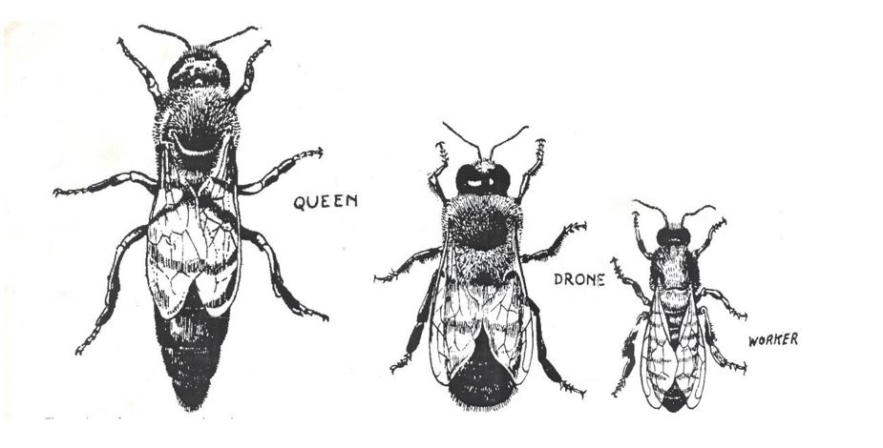
BIOLOGY AND ECOLOGY OF HONEY BEE CONT’
In nature bees usually live in a sheltered cavity, such as a hollow tree or rock crevice. The colony is composed of a queen, drones, and workers.

Slide 21
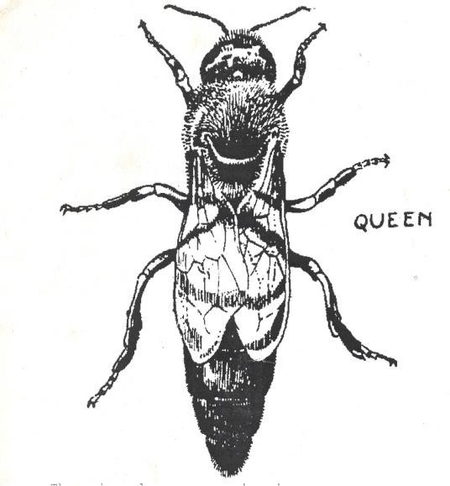
BIOLOGY AND ECOLOGY OF HONEY BEE CONT’
The Queen
This is the mother of all individual bees (the drones and workers) in a colony.
It develops from fertilized eggs and the only female bee capable of laying eggs.
It has a long abdomen than the drones and workers and has a slightly barded sting meant for fighting rival queens (it does not lose the sting after stinging).
Its life span ranges between 3 to 5 years.

Slide 22
BIOLOGY AND ECOLOGY OF HONEY BEE CONT’
Her Duties
To mate with the drones.
To lay eggs e.g. 800 to 3000 eggs per day.
To secrete queen substance (pheromone) meant for promoting colony cohesion and unity.

Slide 23
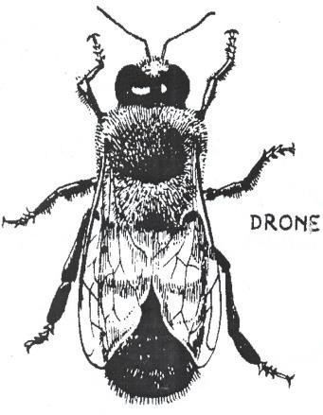
BIOLOGY AND ECOLOGY OF HONEY BEE CONT’
The Drone
The only male bees in the hive and develops from unfertilized eggs.
They have a blunt abdomen and have no sting.
They number from 200 to 2000 in a colony.
Their only duty is to mate with the queen there after shortly they die.

Slide 24
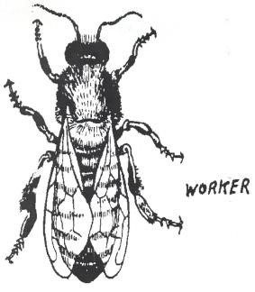
BIOLOGY AND ECOLOGY OF HONEY BEE CONT’
The worker
Female bees produced from unfertilized eggs and lays unfertilized eggs unless in certain circumstances.
They number from 10 000 to 80 000 in a single colony and they are smaller than the queen and drones and their live span ranges from 6 to7 weeks.
All work in the colony is done by the workers except egg lying.

Slide 25
BIOLOGY AND ECOLOGY OF HONEY BEE CONT’
Duties of Workers
Sight and Smell are keenly developed in the worker bee. The worker bee makes use of these senses accurately to find and re-find sources of food, and must also communicate information regarding food sources to other workers. This caste is divided into the following groups;
Scouts bees
Foragers
Guards
Comb builders
Nurse bees
General workers
Young bees

Slide 26
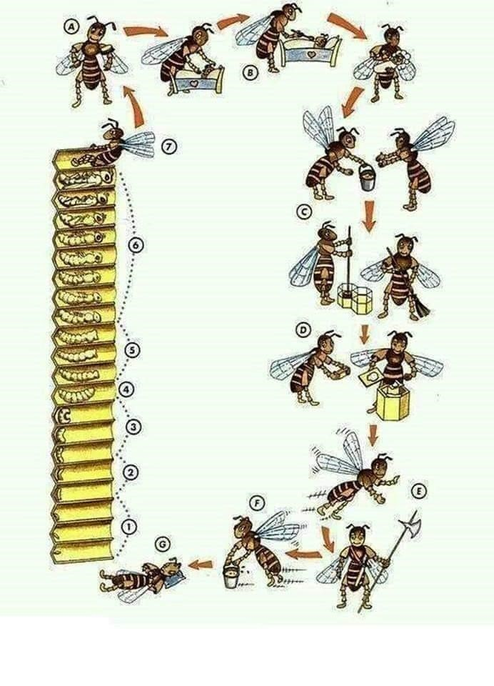
BIOLOGY AND ECOLOGY OF HONEY BEE CONT’
The worker bee does all work in the hive. The work is done according to age and keeps on transitioning. (A)Nursing the larvae (B) Feeding the larvae (C) Help in offloading and packing in cells, also cleaning of comb cells (D) construction of combs (E) Guarding (F) collecting nectar and pollen till death (G)

Slide 27
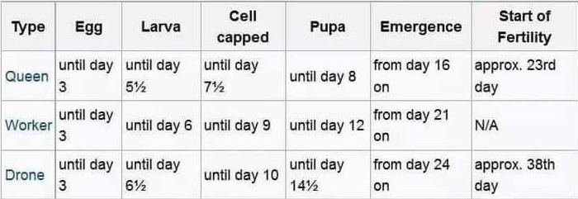
BIOLOGY AND ECOLOGY OF HONEY BEE CONT’

Slide 28
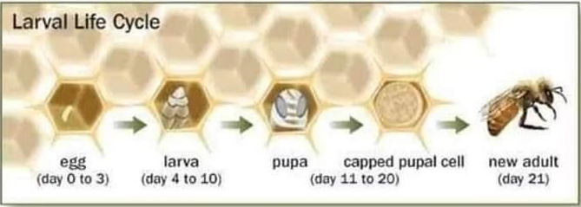
BIOLOGY AND ECOLOGY OF HONEY BEE CONT’

Slide 29
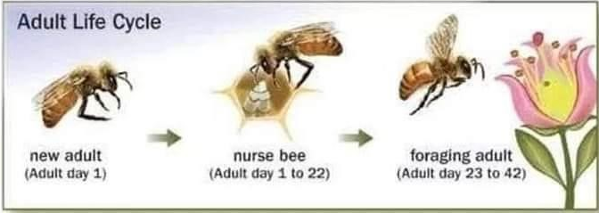
BIOLOGY AND ECOLOGY OF HONEY BEE CONT’

Slide 30
THE END
Thank you for your attention

